Slide 1
Numerical Integration using Simpson 1/3 rule Simpson 3/8 rule
Course Instructor
Engr. Rahemeen
Rahemeen.bukc@bahria.edu.pk

Slide 2
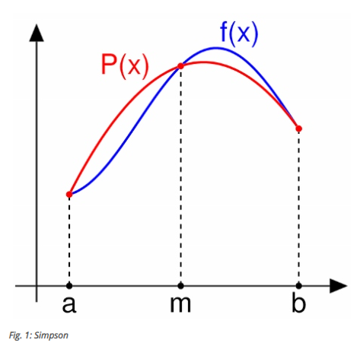
Simpson’s Rule
Simpson’s rule is one of the Newton-Cotes formulas used for approximating the value of a definite integral.
We first divide the function into n equal parts over its interval (a, b) and then approximate the function using fitting polynomial identities.
In Simpson’s rule, the fitting polynomial is a parabolic arc and not a straight line.
we calculate the area under a curve by dividing the total area under the curve into n equal subintervals.
Then we use three successive points in the interval and fit them with parabolas.

Slide 3
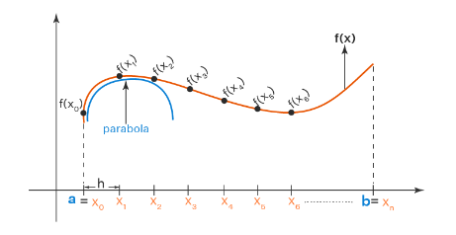
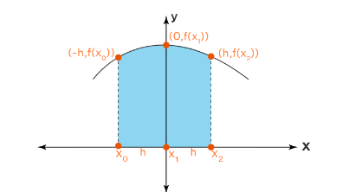
Let us make this parabola symmetric about the y-axis. Then it becomes something like this:

Slide 4
How to Apply Simpson's Rule?
Simpson's 1/3 rule gives a more accurate approximation. Here are the steps that explain how to apply Simpson's rule for approximating the integral ^{b}∫ₐ f(x) dx.
Step 1: Identify the values of 'a' and 'b' from the interval [a, b], and identify the value of 'n' which is the number of subintervals.
Step 2: Use the formula h = (b - a)/n to calculate the width of each subinterval.
Step 3: Divide the interval [a, b] into 'n' subintervals [x₀, x₁], [x₁, x₂], [x₂, x₃], ..., [x_{n-2}, x_{n-1}], [x_{n-1}, x_{n}] using the interval width 'h'.
Step 4: Substitute all these values in Simpson's rule formula and simplify. ^{b}∫ₐ f(x) dx ≈ (h/3) [f(x₀)+4 f(x₁)+2 f(x₂)+ ... +2 f(x_{n-2})+4 f(x_{n-1})+f(x_{n})]

Slide 5
Simpson’s 1/3 Rule
Forward
Simpson’s 1/3rd rule is an extension of the trapezoidal rule in which the integrand is approximated by a second-order polynomial.
In Simpson’s rule, we use three equally spaced points for finding a fitting polynomial and the endpoints are two of them.
This require the number of subintervals to be even.
where,
a, b is the interval of integration
h = (b – a)/ n
y₀ means the first term and yₙ means last term.
(y₁ + y₃ + ..) means the sum of odd terms.
(y₂ + y₄ + …) means sum of even terms.

Slide 6
Simpson’s 3/8 Rule
There is another method for approximation known as Simpson’s ⅜ rule.
This rule is more accurate than Simpson’s 1/3rd rule as it uses cubic interpolation rather than quadratic interpolation.
It has one more functional value which helps to give us more accurate results than any other method.
This rule is applied where N is a multiple of 3.
where,
a, b is the interval of integration
h = (b – a )/ n
y₀ means the first term and yₙ means the last term.
( y₁ + y₂ + y₄ + … ) means the sum of remaining terms.
( y₃ + y₆ +…) means the multiples of 3.

Slide 7
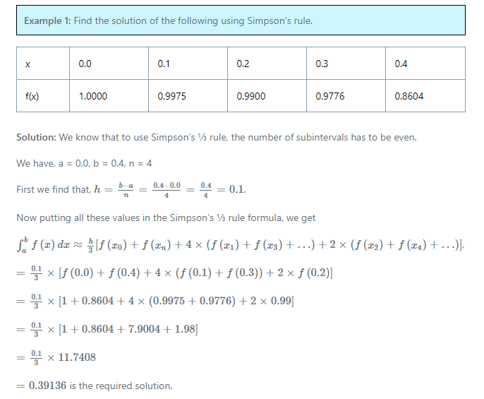
Example

Slide 8
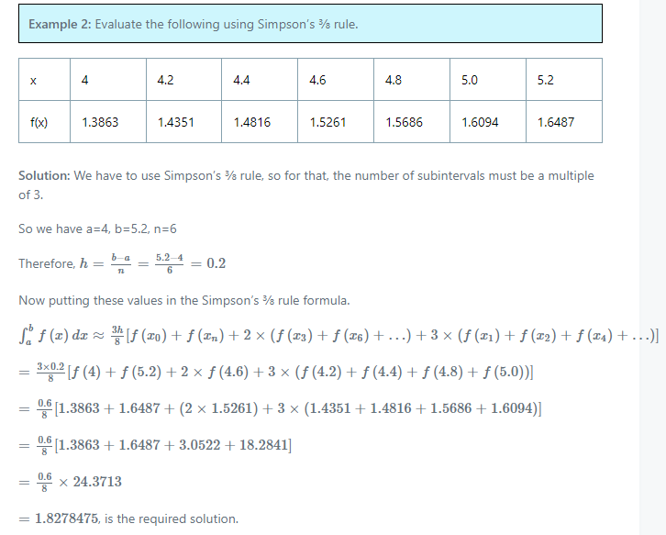
Example

Slide 9
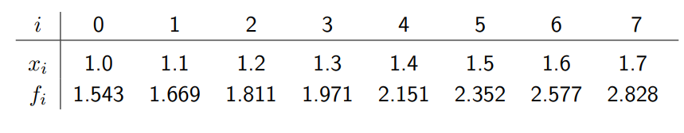
How to solve this?

Slide 10
Exercises
Question # 01:
Alternatively, we could have used Simpson’s–3/8 rule on interval [1.0, 1.3] and Simpson’s–1/3 rule on interval [1.3, 1.7]. Does it reflect on result? Solve it according to the given intervals.
Question # 02:
Solve ∫₀¹ e^{x} dx, by Simpson’s ⅓ rule. Using 4 subintervals.

